Slide 1


CMR TECHNICAL CAMPUS UGC (Autonomous) Kandlakoya, Medchal Road, Hyd-501 401 Department of Electronics & Communication Engineering Real Time Project Review TITLE OF THE PROJECT Identification Authentication For Examination System
BATCH NO : 20
Project Guide : DONE BY :
Dr.DTV Dharmajee Rao 227R1A05C1 - SOUMYA SAHU
Professer of CSE Department 227R1A05B9 - HANSINI SADAK
Project Coordinator : 237R5A0510 - MAIDEM VEEKSHITHA
G Pavan Kumar
PROFFESOR

Slide 2
CONTENTS
ABSTRACT
INTRODUCTION
LITERATURE SURVEY
PROPOSED METHODOLOGY
ARCHITECTURE
RESULT AND DISSCUSSION
CONCLUSION AND FUTURE SCOPE
REFERENCES

Slide 3
ABSTRACT
Examination System is an effective solution for mass education evaluation. The novel online examination system based on Browser/Server framework which carries out the examination and auto-grading for objective questions and operating questions has been successfully applied to the distance evaluation of basic operating skills of computer science.
. A fingerprint identify/classify application and a load balance service are implemented on the examination server cooperated with the online examination system to accomplish authentication.

Slide 4
INTRODUCTION
Authentication mechanisms in examination systems serve to validate the identities of candidates, thereby preventing unauthorized access and fraudulent activities.
Traditional methods such as username-password combinations have long been used but are increasingly complemented or replaced by more advanced technologies like biometric authentication (e.g., fingerprint or facial recognition) and multi-factor authentication (MFA).
This introduction explores the evolution and importance of identity authentication within examination systems.

Slide 5
LITERATURE SURVEY
Biometric Authentication: Several biometric methods are used for identity verification in examination systems, including facial recognition, fingerprint scanning, and iris recognition. These methods are more secure than traditional username and password systems, as they rely on unique biological traits that are difficult to replicate​
Multimodal Biometric Systems: Combining multiple biometric traits, such as fingerprint, facial, and vein pattern recognition, can enhance the accuracy and security of authentication systems.

Slide 6
PROPOSED METHODOLOGY
Define Authentication Requirements
Review Authentication Methods
Select Authentication Technology
Design Authentication Workflow
Implement Authentication Protocols
Training and User Education
Monitor and Evaluate

Slide 7
ARCHITECTURE
POWER SUPPLY
AT89S52
BUZZER
M
A
X
2
3
2
L
A
T
C
H
IC
FINGER PRINT SCANNER
ENROLLING
KEYS
LCD
PC

Slide 8
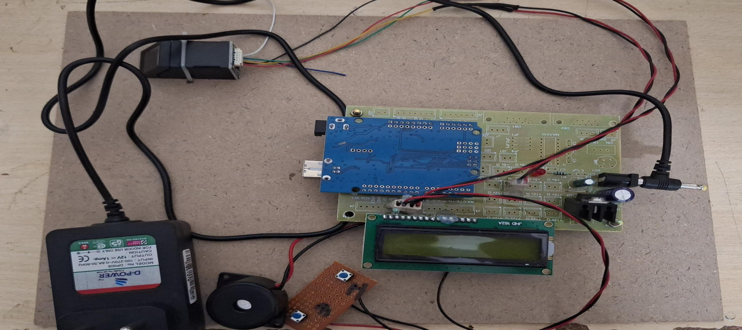
RESULTS & DISCUSSION

Slide 9
CONCLUSION AND FUTURE SCOPE
Identity authentication for examinations is a critical aspect of ensuring the integrity and fairness of the assessment process. The evolution of technology has provided robust methods to authenticate candidates, ranging from traditional ID checks to sophisticated biometric and multi-factor authentication systems.
FUTURE SCOPE:
Artifical Intelligence and Machine learning
Blockchain Technology
Advanced Biometrics
Improved User Experience

Slide 10
REFERENCES
Grech, A., & Camilleri, A. F. (2017). "Blockchain in Education". European Commission Joint Research Centre. Link.
Agarwal, S., & Jain, A. K. (2019). "Biometric Authentication in Online Assessment: A Review". Journal of Educational Technology & Society. Link.
Grech, A., & Camilleri, A. F. (2017). "Blockchain in Education". European Commission Joint Research Centre.
Jones, M., & Sallis, P. (2013). "Digital Forensics and Cyber Crime: Lecture Notes of the Institute for Computer Sciences, Social Informatics and Telecommunications Engineering". Springer.

Slide 11
Q&A

Slide 12
THANK YOU

